Slide 1
Federalism and the Power to Tax in Times of Crisis
Jonathan Rodden
May 2022

Slide 2
Overview
Social cleavages and the power to tax
Benefits and costs of local tax autonomy
Centralizing forces:
War
Crises: Recessions and pandemics
Inequality
Polarization: the temptation of domination
Conclusions

Slide 3
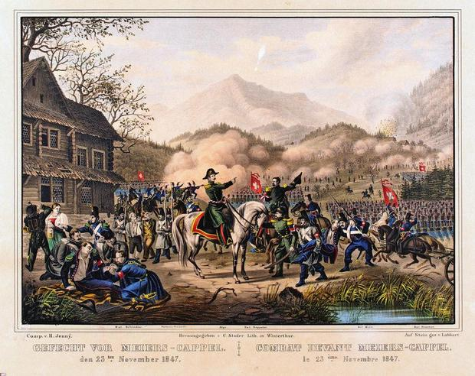
Why do some countries sustain a decentralized system of taxation, expenditure, and regulation?
Salient, persistent social divisions going back to the founding of the federation
Sonderbund
U.S. conflict over slavery, Civil War, modern polarization
Canada: enduring conflict over language and culture
Decentralized federalism is sustained in part by these divisions (or their institutional legacies)

Slide 4
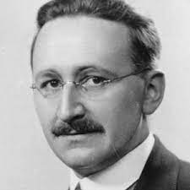
Some benefits of this arrangement
Fiscal sovereignty and fiscal discipline
Accountability, limited government, citizen control
Friedrich Hayek
Barry Weingast

Slide 5
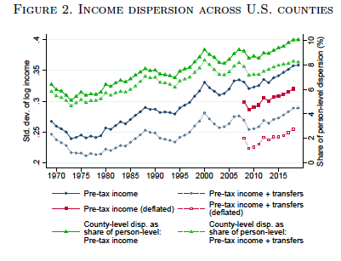
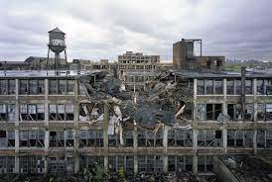
But also perhaps some costs in the U.S.
In the United States:
Poverty traps and “left behind” places
Cross-state and cross-county income divergence
Source: Gaubert et al. 2022

Slide 6
Local fiscal sovereignty can be difficult to maintain
Even decentralized federations with pronounced social divisions have faced significant challenges to local autonomy over time
The history of fiscal and administrative centralization is a history of crisis and response
Temporary reforms become permanent
Ratchet effects

Slide 7
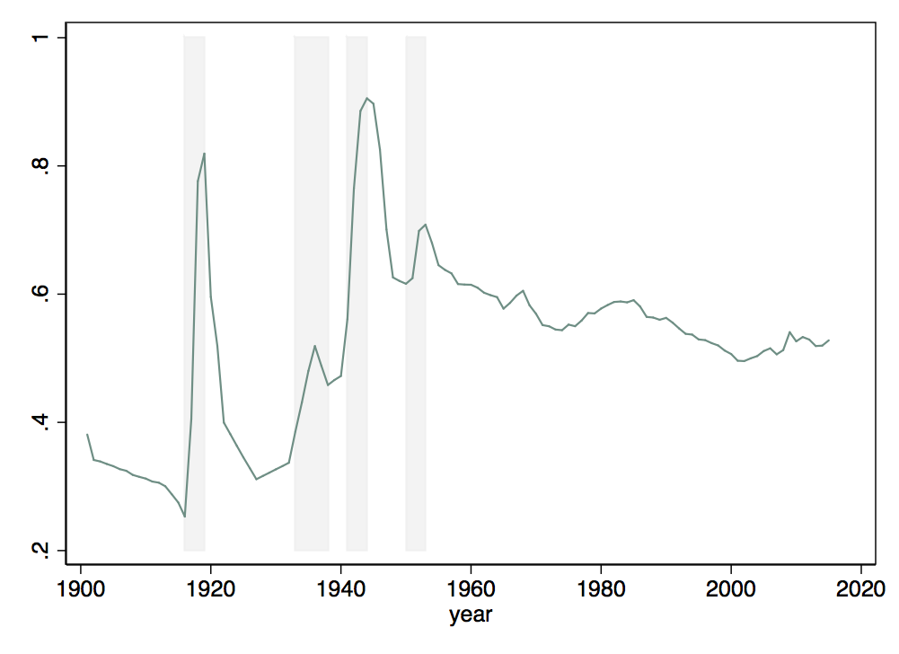
Federal expenditures as a share of total (federal, state, municipal) expenditures in the United States, 1900 to present
WWIII
New Deal
Koreaa
WWI

Slide 8
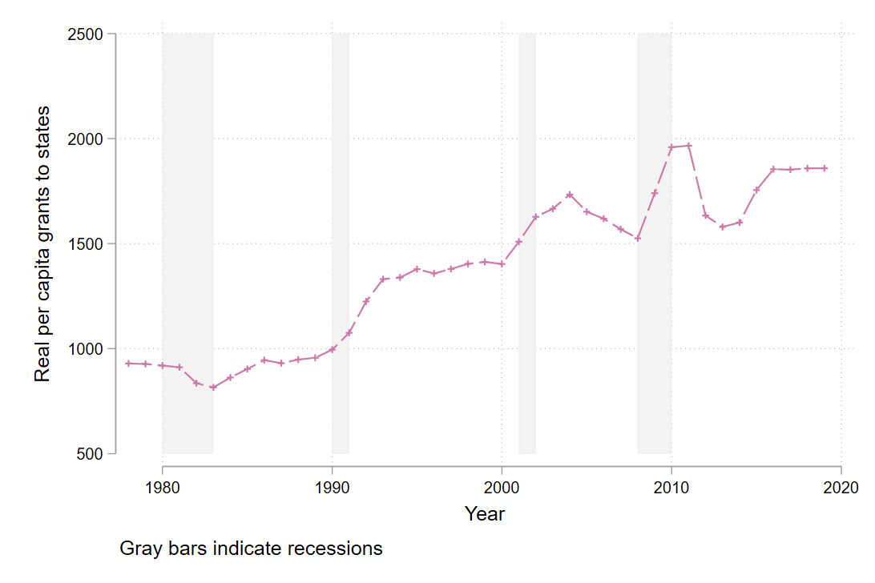
Real Grants Per Capita from the Federal Government to the States, 2012 USD

Slide 9
Crisis and Response in the United States
No equalization; no system of automatic stabilizers
Large role for states in implementing Medicaid and other programs
States face self-imposed borrowing restrictions
This leads to 11th hour, rushed packages of emergency assistance
Per capita payouts with generous floor for poor states, very poorly targeted
Little of the money makes its way to local governments, where most public employment takes place

Slide 10
Whatever it takes?
Municipal Liquidity Facility
A Federal Reserve program offering to buy up to $500 billion in debt from state and local governments that suffered revenue declines as a result of the COVID-19 pandemic.
Appears to have had a big impact on yields
With very little program take-up

Slide 11
When have violations of local fiscal sovereignty gone too far?
Do market actors believe there is a lingering federal guarantee?
Do state and local governments behave as if they have an implicit guarantee?
Perhaps chaotic bargaining and poor targeting do not install confidence in future bailouts.

Slide 12
Another slow-moving threat to local autonomy: Regional inequality
Aristotle:
The rich are few and the poor are many
Democracy as the “rule of the poor”
Can decentralization be retained when the tax base is highly concentrated in a handful of ”knowledge economy” cities?

Slide 13
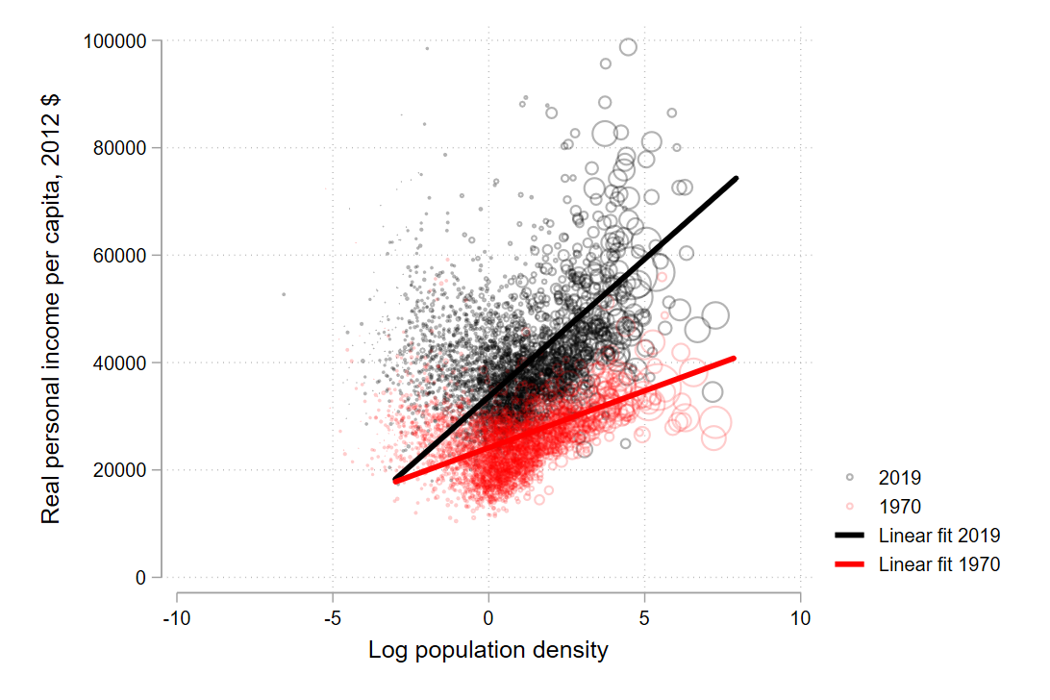
Population Density and Real Personal Income per Capita, U.S. Counties, 1970 and 2019 (BEA)

Slide 14
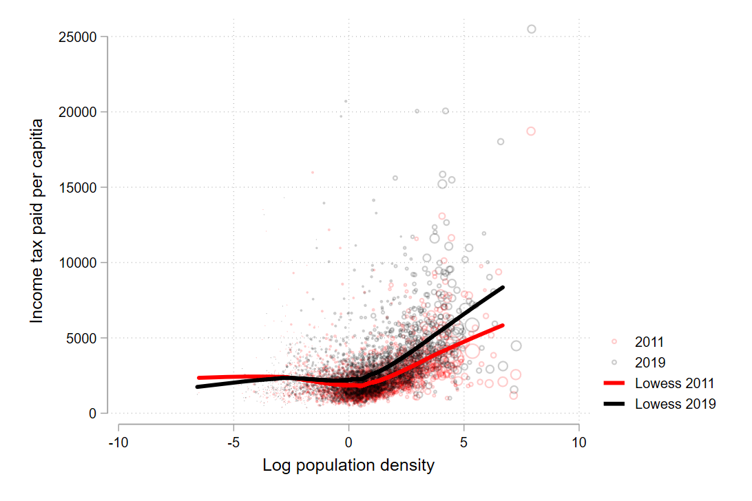
Population Density and Federal Income Tax Paid per Capita,
U.S. Counties, 2011 and 2019 (IRS)

Slide 15
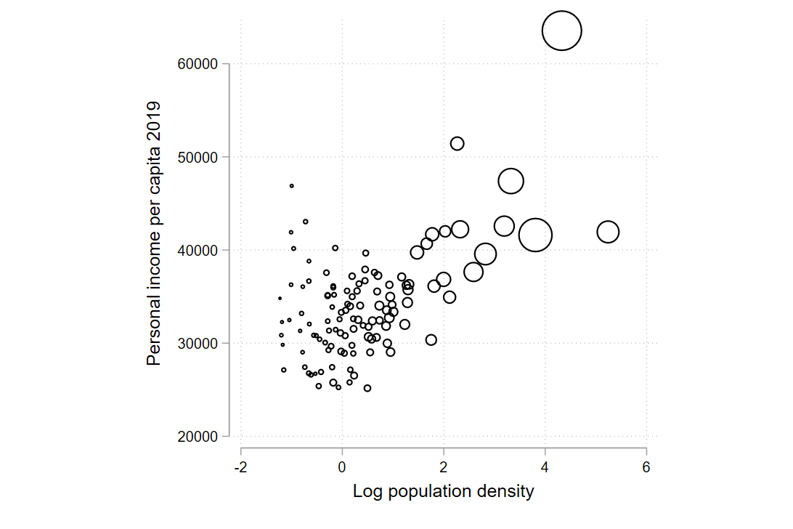
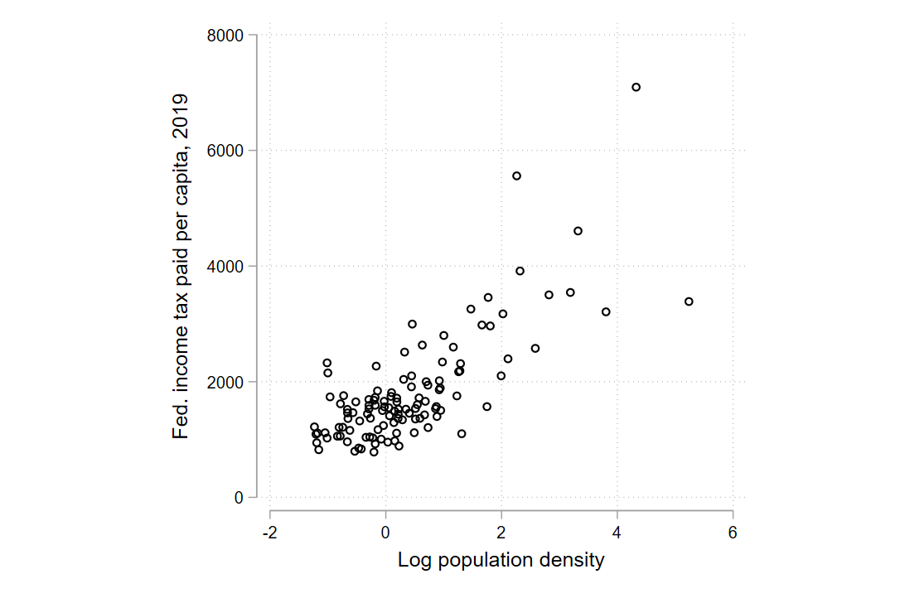
Missouri,
Population density and Personal Income per Capita, 2019
Missouri,
Population density and Fed. Income Tax Paid per Capita, 2019

Slide 16
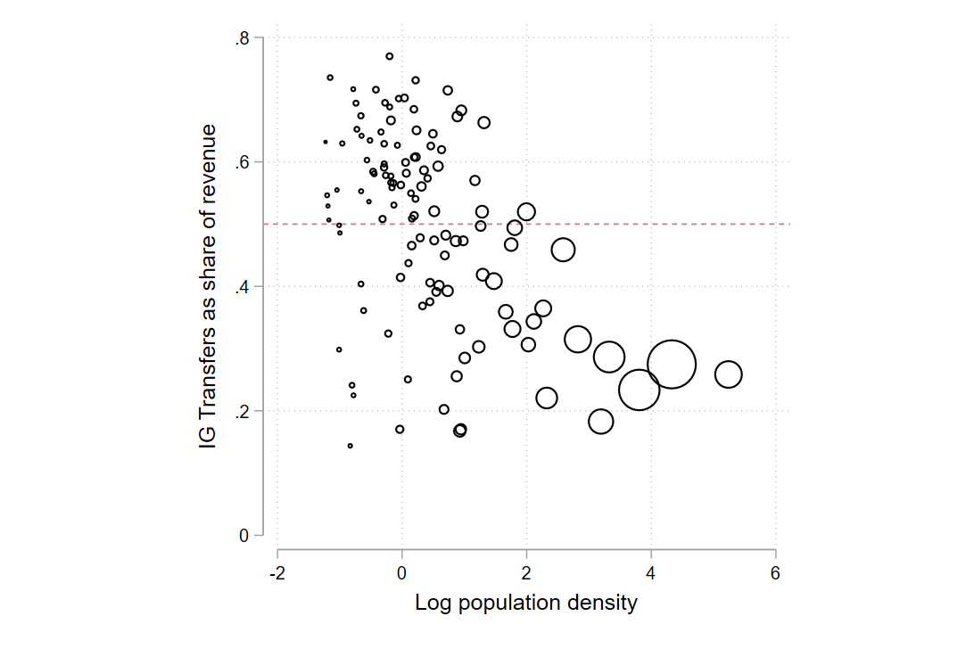
Missouri:
Population Density and Dependence on Inter-Governmental Transfers

Slide 17
A final threat to local autonomy: Polarization
Deep social divisions might facilitate and uphold local autonomy, but without institutional protections, they can undermine it
The ”new preemption” in the United States
Confluence of rurality, low tax base, transfer-dependence, and anti-urban sentiment in political coalitions controlling U.S. states in the South and Midwest
A striking trend toward centralization in recent years, including limits on tax powers of local governments
Only urban residents seem interested in protecting the local power to tax

Slide 18
The future of local autonomy in the United States
More important than ever given the possible return of abortion policy to the states
But this policy area also reveals the weaknesses of local autonomy as a solution to polarization
Externalities, interjurisdictional battles
The temptation of centralization during moments of strength

Slide 19
Discussion questions: the U.S. vs. Switzerland
Better mechanisms for managing the business cycle in Switzerland?
Less divergence of income and tax base in Switzerland?
If true, why?
Less geographic/partisan polarization?
If true, why?
The importance of unique Swiss institutions, including the referendum?

